Slide 1


The Nursery Curriculum
Curriculum Evening

Slide 2
Purpose of our meeting
Share some information about the Early Years Curriculum and how we teach it.
To give parents a better understanding of what to expect this year.

Slide 3
The EYFS
The Early Years Foundation Stage is a curriculum devised for children from birth to five.
The framework: sets the standards that all early years providers must meet to ensure that children learn and develop well; ensures children are kept healthy and safe.
This stage prepares the children for the rest of their school journey.
7 areas in the EYFS curriculum 3 Prime areas and 4 Specific areas

Slide 4
Prime Areas
Personal, social, emotional development (PSED) – comprising self confidence, feelings, behaviour and relationships.
Communication and language (CL) – comprising listening and attention, understanding and speaking.
Physical Development (PD) – comprising moving and handling and self-care.

Slide 5
PSED
This involves co-operative play, turn taking, being sensitive to other’s needs and feelings.
To be able to speak in a familiar group and share their ideas.
To be confident to try new activities and just have a go!
To show increasing independence in selecting and carrying out activities.
We have a planned Circle time session once a week.
We will introduce the coloured bear zones to help regulate emotions

Slide 6
Communication and Language
Listening and attention
Understanding
Speaking
Extra session given - in a small group to practice communication and language skills.

Slide 7

Physical Development
This includes being able to control their movements, moving in a range of ways, safely negotiating space.
To handle tools and equipment safely including pencils and scissors.
To know the importance of good health and physical exercise.
To manage their own basic hygiene and personal needs including dressing and going to the toilet independently.
We have a planned P.E session outside each week.
We take part in super hero training each week.
We learn in our forest school classroom

Slide 8
Specific Areas
Literacy (L) –comprising of reading and writing
Mathematics (M) – comprising numbers, space, shape and measures.
Understanding the world (UW) – comprising people and communities, the world and technology
Expressive arts and design (EAD) – comprising exploring and using media and materials and being imaginative

Slide 9
Literacy
One of the main focuses of literacy at this age is the ability to listen and communicate with others.
Three times a week we teach a phonics lesson which concentrates on developing children's speaking and listening skills and lays the foundations for the phonic work which starts in Reception.
We have a planned Literacy session each week.

Slide 10
Maths – numbers, shape – space and measures
Working with numbers, which includes counting objects and representing an amount.
Shape, Space and measures, which includes an awareness of the shapes in their environment and talking about them.
Every Friday we have a number block learning session and every other week as part of our focused time we have a planned Maths session. We also have a number rhyme of the week where we look at numbers in depth.
During CIL we put out maths resources for children to explore. This is also a time where we work with the children independently.

Slide 11
Understanding of the World
This incorporates the use of computing, learning about the world around us, changes, past and present events, communities and traditions.
FOREST SCHOOLS
Science Experiments and exploration
COOKING

Slide 12
Expressive Art and Design
Being imaginative by representing their own ideas through design and technology, art, music, dance, role-play and stories.
This area covers singing songs, making music, exploring a variety of materials, tools and techniques.

Slide 13
Topics
We theme our teaching throughout the year, this allows us to teach the various objectives through child friendly and meaningful topics.
Once we get to know our children we decide on the topic best suited to them. Allowing their interests to help them learn other concepts.
Examples of past topics - Ourselves, Paw patrol, dinosaurs, super heroes, space

Slide 14
Planning in the Moment
Children choose their own activities CIL
Can the adult add anything of benefit
Enhance learning through Open ended questions
Draw on previous knowledge
Help make links
Demonstrate new skills

Slide 15
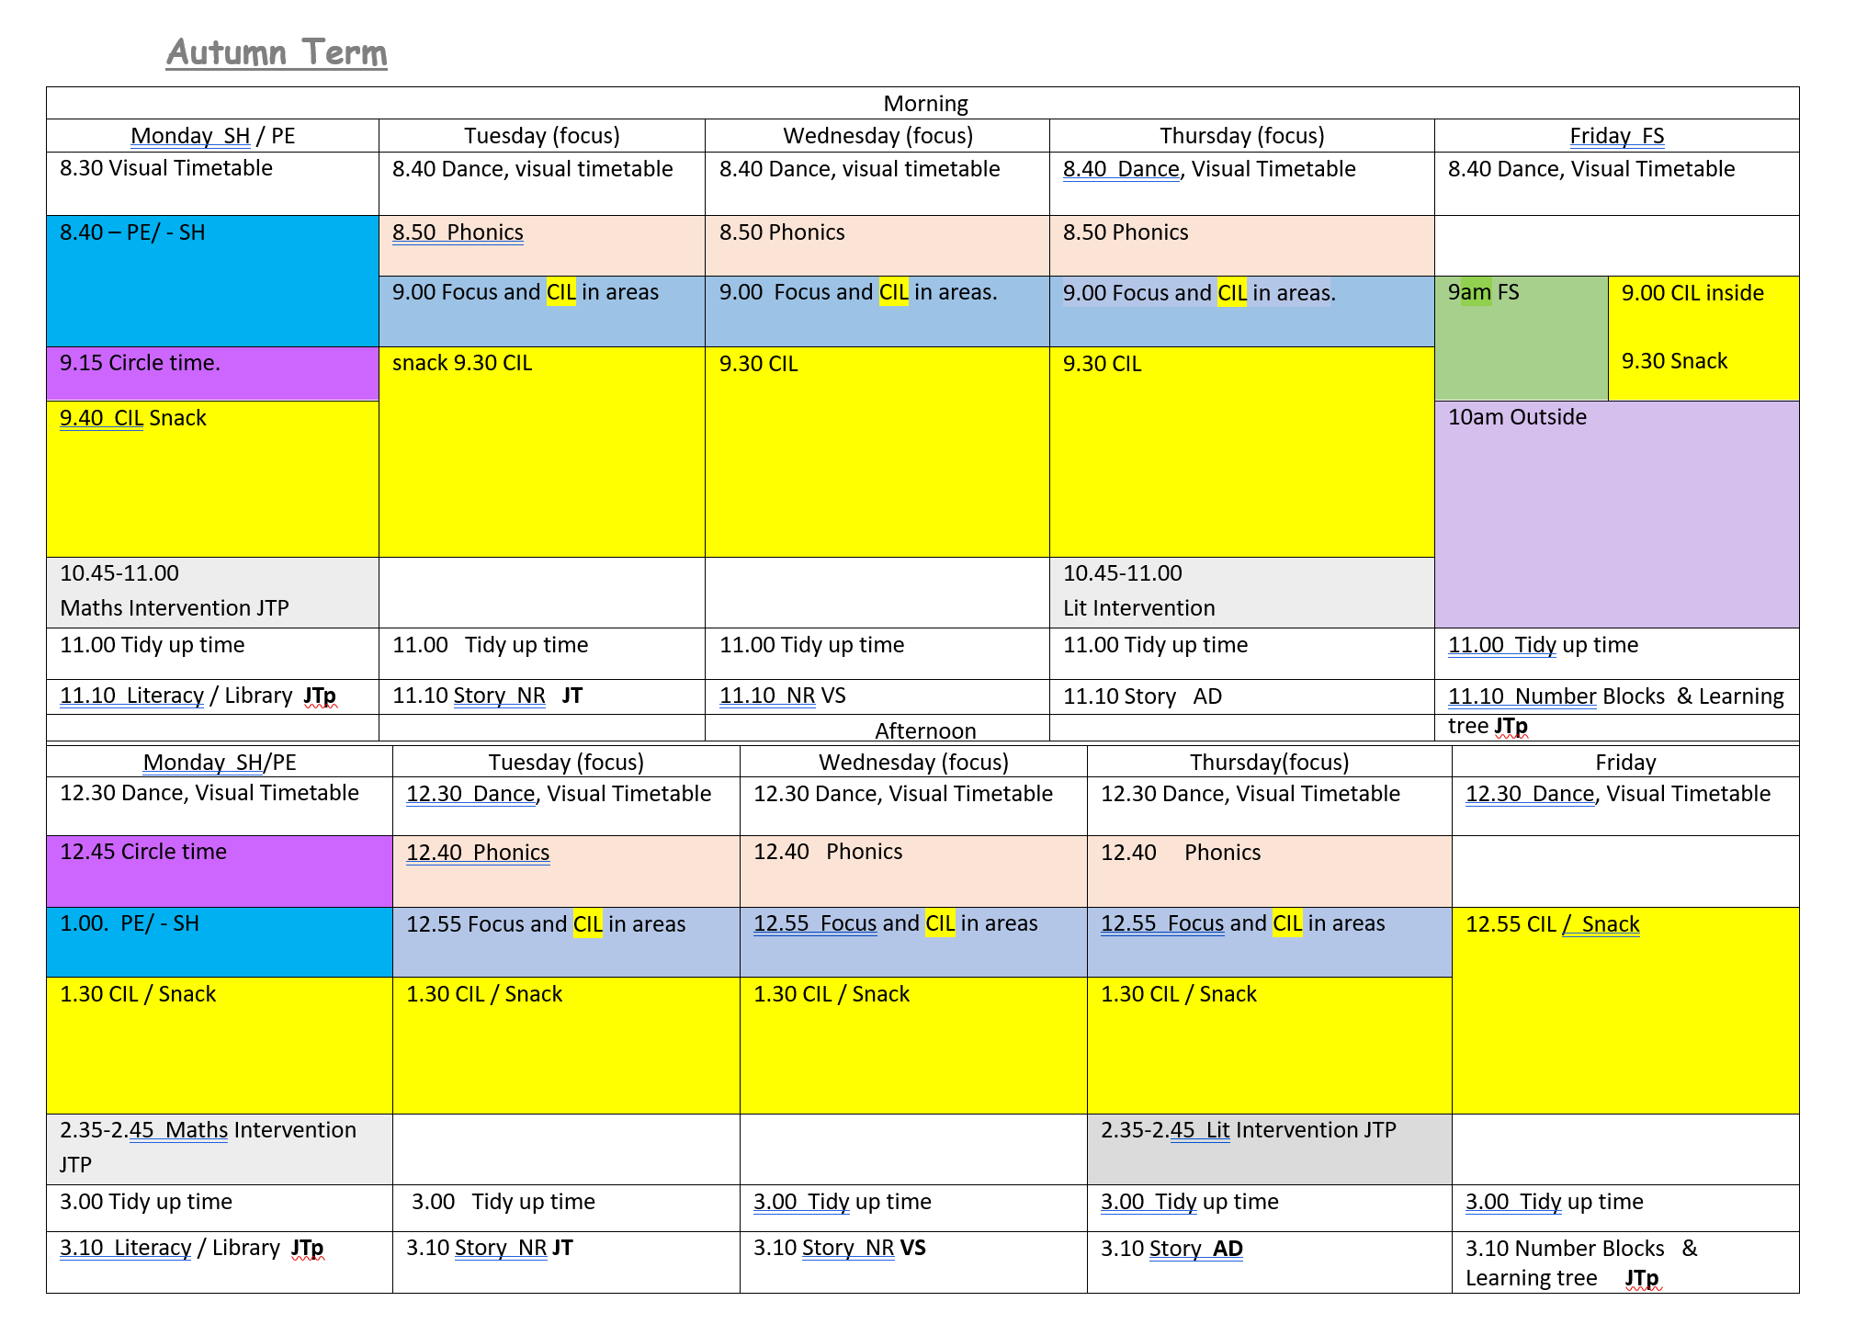
What does the week look like?

Slide 16

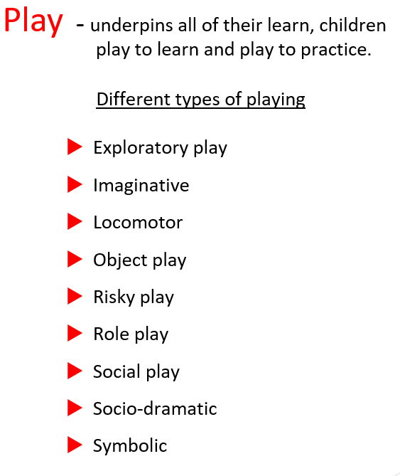
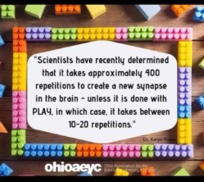

Slide 17
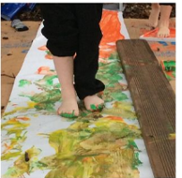
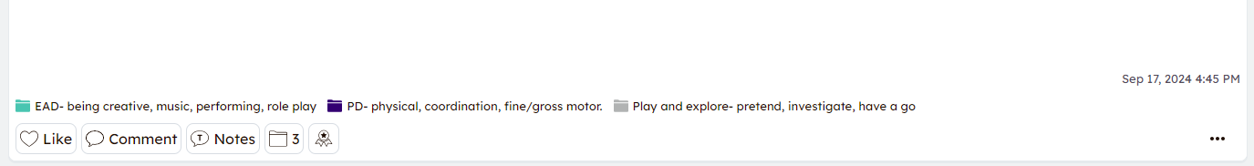
Seesaw
Our new on-line journal – teachable moments.
Blog
No sharing photos - posting on social media. No sharing on WhatsApp
Questions

Slide 18
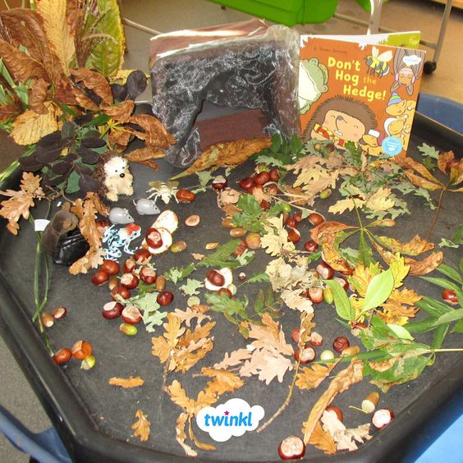
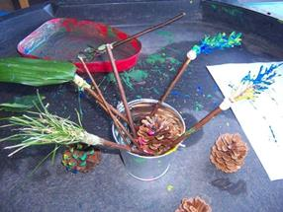
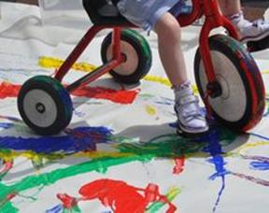

Slide 19
Play
– underpins all of their learn, children
play to learn and play to practice.
Different types of playing
Exploratory play
Imaginative
Locomotor
Object play
Risky play
Role play
Social play
Socio-dramatic
Symbolic

